Slide 1
Positive Behaviour Supports
Social Emotional Supports

Slide 2
Social emotional learning (SEL)
The processes of developing competencies in the areas of:
Self awareness
Self management
Social awareness
Relationship skills
Responsible decision making

Slide 3

Self awareness
Knowing your strengths and limitations

Slide 4

Self management
Being able to stay in control and persevere through challenges

Slide 5

Social awareness
Understanding and empathizing with others

Slide 6
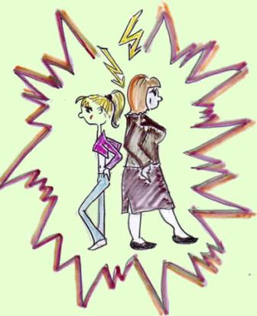
Relationship skills
Being able to work in teams and resolve conflicts

Slide 7

Responsible decision-making
Making safe and ethical choices

Slide 8
Replacement Skills
Direct teaching of and with:
Calm down and relaxation strategies
Self-management/monitoring tools
Recognizing emotions and feeling states in self and others
Power cards
Social narratives

Slide 9

What can you do about stress?

Slide 10
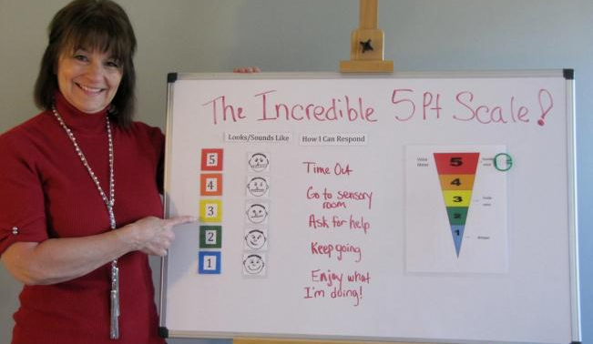
5 point scale

Slide 11
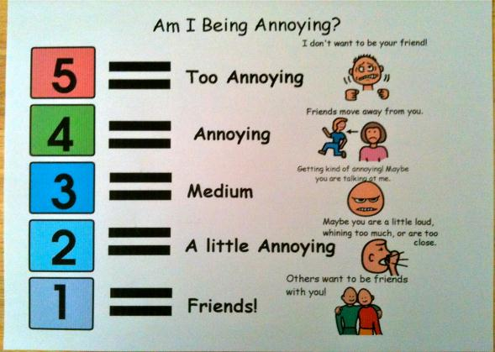
5 point scale applications

Slide 12

Social Narratives
Written descriptive accounts or stories (often visually represented) that describe social situations and socially appropriate responses or behaviours
Social skills include:
Communication
Problem solving
Decision-making
Self-management
Peer relations

Slide 13
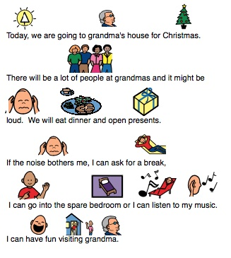
Social Narratives
Help students gain information about thoughts and feelings of self and others, as well as contextual information
Effective and inexpensive strategy

Slide 14
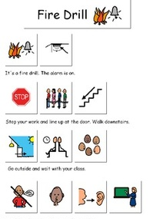
Social Narratives
Written at the student’s language and learning level
Use visuals to enhance understanding of the content
Can develop in conjunction with the student
Use must be taught through direct instruction

Slide 15
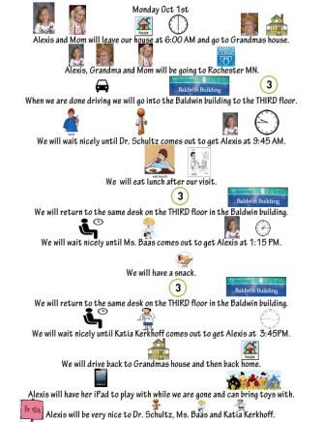
Social Narratives
Use:
After a social “error”
Prior to a transition or new experience
As an intervention to reduce existing recurring behaviors

Slide 16

Social Narratives
Student response:
If, after 2 weeks of continual use there isn’t a sign of a positive response the narrative and implementation procedures should be reviewed

Slide 17
Social Scripts
provide pre-taught language for specific situations
involve conversation starters, responses and ideas to connect conversations or change the topic
can reduce the stress associated with social interactions and assist the child with understanding the perspective of others
include informal language, slang or child-specific terms to help the conversational exchange appear more natural

Slide 18
Guidelines for Developing Social Narratives
Identify a social situation for intervention
Define the target behaviour
Write the narrative using language at the individual’s level
Choose the number of sentences per page according to the individual’s abilities
Use photographs, hand drawn pictures or pictorial icons

Slide 19
Guidelines for developing social narratives
Read the social narrative to the individual and model the desired behaviour.
Teach and use. Observe the targeted behaviour (collect data).
Review the data and revise the narrative, procedures for implementation or form of the narrative, as appropriate.
Gradually fade the social narrative at the appropriate time.

Slide 20
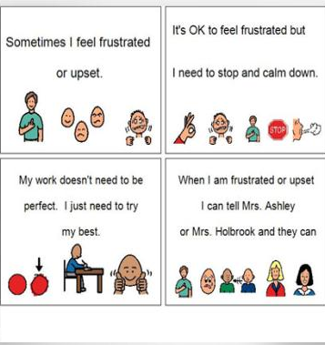
Social narrative formats
Usually as a story in book form
Other formats:
Power points
Limit the amount of information per slide
Use visuals or animations
Allows the student to control how long s/he looks at each slide
Can insert voice recording

Slide 21

Example

Slide 22
Social Stories™
Individualized stories that describe a social situation, often from the individual’s point of view
Includes information about how others feel, where and why the situation occurs, how others may react to the situation
Written in a specific delineated format (as developed by Carol Gray)

Slide 23
Social Stories™
At least ½ the story provides positive reinforcement for an achievement or for doing something well
Written using positive language
Contain mostly descriptive sentences but also perspective, directive and affirmative sentences. Cooperative and control statements may be included.
No more than one direction or control sentence and at least two (but not more than five) of the remaining sentence types)
Use terms like usually, sometimes and avoid terms like “you should” or “you need to”

Slide 24
Sentence types
Type | What is it? | Examples
Descriptive | Answers the “wh” questions where does the situation occur, who is it with, what happens and why? Descriptive sentences need to present information from an accurate and objective perspective | Christmas Day is December 25. Most children go to school. Sometime I get sick.

Slide 25
Sentence types
Type | What is it? | Examples
Perspective | Refers to the opinions, feelings, ideas, beliefs or physical/mental well being of others | My Mum and Dad know when it is time for me to go to bed. Teachers like it when students raise their hand to ask a question in the classroom.

Slide 26
Sentence types
Type | What is it? | Examples
Directive | Gently offers a response or range of responses for behaviour in a particular situation. It is important that these sentences have a positive focus and are constructed in ways which allow flexibility (avoid statements like I must or I have to. | I will try to cover my mouth when I cough. I might like to play outside during lunchtime. When I am angry I can:

Slide 27
Sentence types
Type | What is it? | Examples
Affirmative | Statements that enhance the meaning of the previous sentence (which can be descriptive, perspective or directive) and can be used to emphasize the importance of the message or to provide reassurance to the person. | I will try to hold an adult’s hand when crossing the road. This is very important. Thunder can be very loud. This is ok.

Slide 28
Sentence types
Type | What is it? | Examples
Co-operative | Sentences which identify how others may be of assistance to the person | Mum and Dad can help me wash my hands. An adult will help me when I cross the road. My teacher will help me to try and stay calm in class.

Slide 29
Sentence types
Type | What is it? | Examples
Control | Statements written by the person themselves to provide personal meaning to a particular situation and to assist them to recall and apply information | My body needs food several times per day; just like a steam train needs coal to stay running.

Slide 30
Sentence types
Type | What is it? | Examples
Partial | Incomplete sentences, which allow the person to guess the next step in a situation, and may be used with the other types of sentences. | My name is ______ (descriptive sentence). Mum and Dad will feel ______ if I finish all my dinner (perspective sentence).

Slide 31

Examples

